Slide 1

Frontend Presentation

Slide 2
INTRODUCTION
Angular, a popular front-end JavaScript framework, offers a powerful and flexible platform for building dynamic web applications.
Leveraging Angular's capabilities, we have created data-rich tables that not only present information in a visually appealing manner but also offer interactivity, sorting, filtering, and seamless data manipulation.

Slide 3
Reusable Component
UI Components
Data Display Components
Layout Components
Form Components
Directive Components

Slide 4
Technologies Used
Angular Framework -15
Visual Studio -1.80.2
Node JS-18.12.1

Slide 5
Feature Set
Data Filtering
Data Export
Keyboard Navigations
Freezing Rows
Data Manipulation
Tree Data

Slide 6
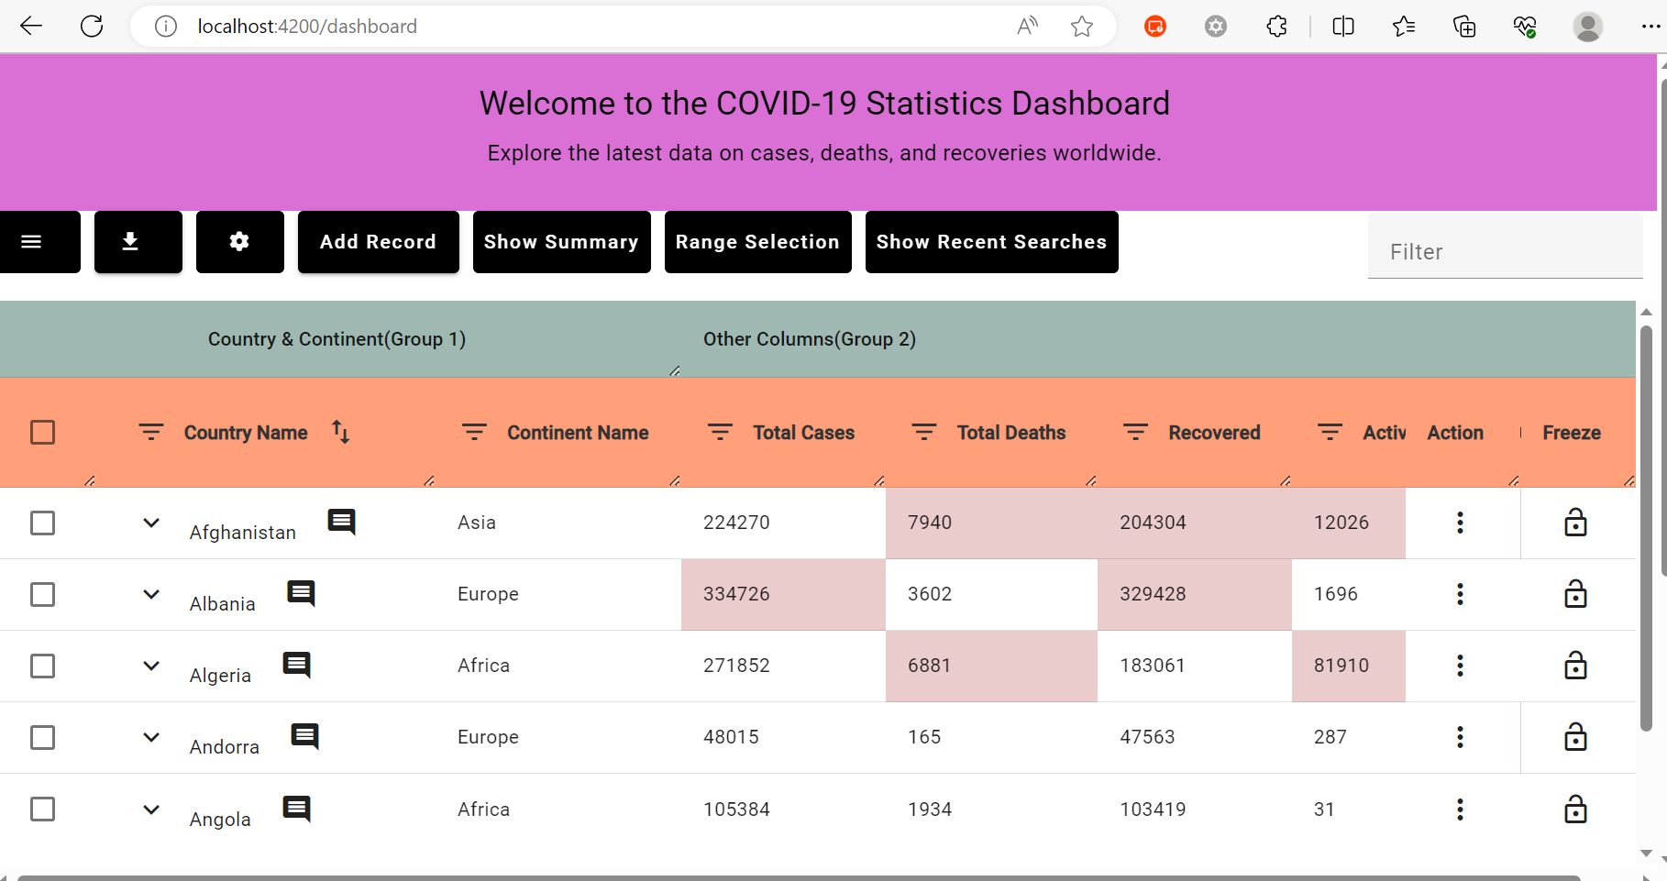
SNAPSHOTS: Dataset 1

Slide 7
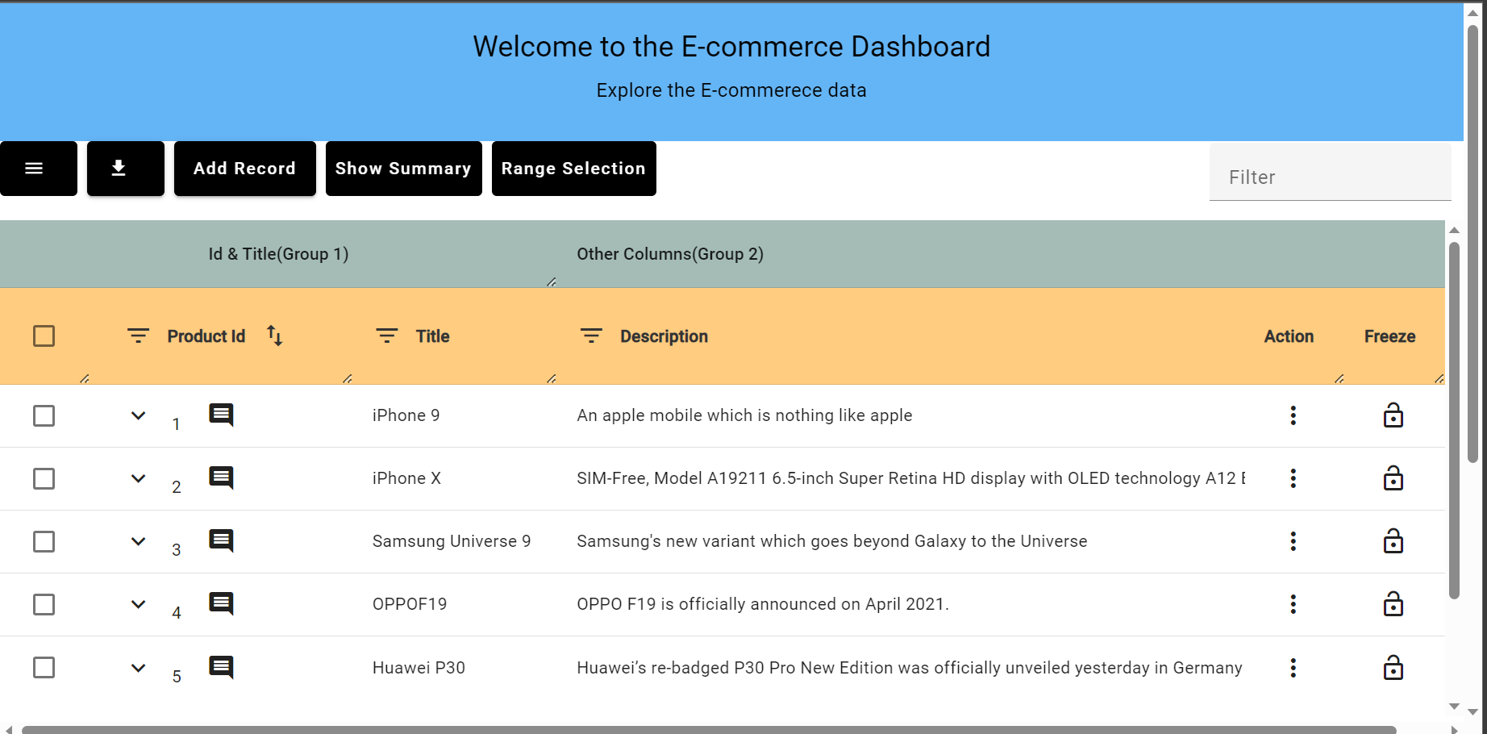
Dataset 2

Slide 8
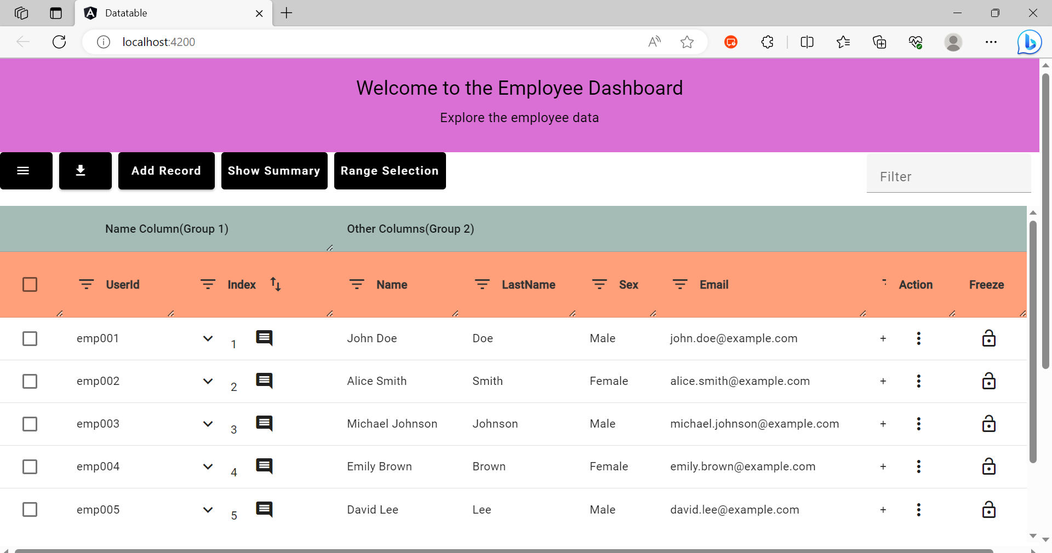
Dataset 3

Slide 9
CONCLUSION
During the development of this web application, we had the opportunity to explore and learn numerous new concepts in Angular, significantly enhancing our knowledge and expertise in the framework.

Slide 10

THANK YOU

